Slide 1
NARR Conference
Presenter:
John Shinholser
https://events.narronline.org/summit/agenda

Slide 2
We’re Talking Leadership !
We’re Talking Recovery Leadership
We’re Talking Recovery Residence Leadership
“Lead by Example”
Notes:
Example covers everything from experience to institutional knowledge

Slide 3
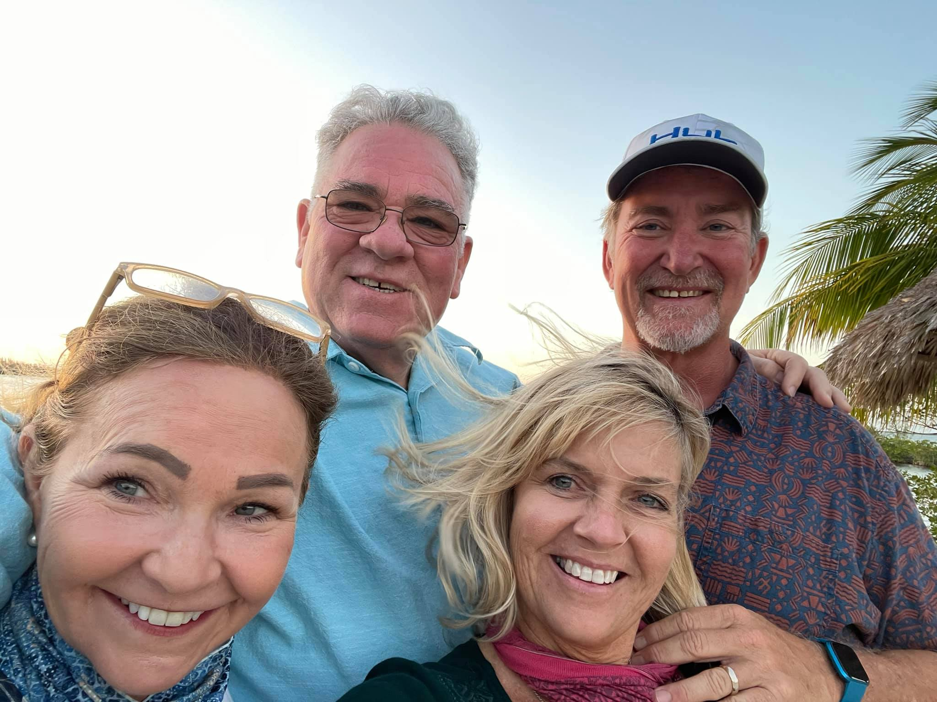
What is your example ? What Qualifies You ? Lived Experience:
Actual Sample
Dysfunctional group living
Active addiction survivor
Treatment/Recovery experience
Recovery Residence pioneer
Problem solving
Sustainable leadership

Slide 4
My 3 Leadership Traits
Honor
Commitment
Courage

Slide 5
Honor
Honor
This is the bedrock of our character. It is the quality that empowers recovery leaders to exemplify the ultimate in ethical and moral behavior:
Do not cheat lie or steal, abide by recovery principles, respect human dignity; and have respect and concern for each other. It represents the maturity, dedication, trust, and dependability that commit recovery leaders to act responsibly, be accountable for their actions, fulfill their obligations, and hold others accountable for their actions.

Slide 6
Commitment
Commitment
This is the spirit of determination and dedication within members of recovery leadership roles that leads to professionalism and best outcomes in the recovery space. It promotes the highest order of discipline for organizations and self and is the ingredient that instills dedication to recovery, pride, concern for others, and an unrelenting determination to achieve a standard of excellence in every endeavor. Commitment is the value that establishes recovery leaders as the “recovery warrior” and citizen others strive to emulate.

Slide 7
Courage
Courage
The heart of our Core Values, courage is the mental, moral, and physical strength ingrained in recovery leaders that sees them through the challenges of “living life on life’s terms”, and to do what is right, to adhere to a higher standard of personal conduct, to lead by example, and to make tough decisions under stress and pressure. It is the inner strength that enables a recovery leader to take that extra step.

Slide 8
Thank you!
Contact:
John Shinholser
johns@mcshin.org
804-241-9424

