Slide 1
NARR Past, Present and Future
October 25, Richmond VA
Fred Way, Board President
Dave Sheridan, Executive Director

Slide 2
Past: Recovery housing history, founding, 2011-2014

Slide 3
NARR at a glance
Founded in 2011
National Standard and Code of Ethics
Covers the full spectrum of recovery housing
Operating model for statewide recovery housing support systems
Affiliate relationships in 31 states, over 3,500 residences nationally
Training, technical assistance; working relationships with gov’t agencies
Certification program implemented by state affiliate organizations
Policy development
Advocacy: access, support, civil rights

Slide 4
History of recovery housing pre-2010: marginalized existence
Recovery housing predates treatment
Mostly ignored, unregulated under existing system
Virtually no consumer awareness
No widely-accepted standards
Not part of larger systems of care, no institutional support
Oxford House model adopted in a few states
A few regional standards/support organizations including a predecessor of CCAPP
But addiction professionals were beginning to refer their clients there
Notes:
My best thinking …
What do you mean you can’t fix me in 28 days?
What the #*&@ is sober living? I’m a grownup.
Life gets busy …
Yoda
Realized that this was the most important post-treatment recovery service that NOBODY cared about

Slide 5
Recovery housing in the continuum of recovery

Slide 6
Covers Many Aspects of Human Experience
Health
Home
Recovery Support Domains
(SAMHSA)
Purpose
Community
Notes:
Recovery is:
A process of change through which individuals improve their health and wellness, live a self-directed life, and strive to reach their full potential.

Slide 7
SUD recovery process
High
Service intensity
Long-term recovery:
Independent, meaningful living in the community
Low
Stabilization
Recovery process duration
Notes:
Our systems spend a great deal on acute and sub-acute care. That care is necessary, but we have to remember that addiction is a chronic disease. Like other chronic conditions, addiction takes time to be placed in remission. We devote far too little attention to the supportive services required to improve recovery, health and social outcomes.

Slide 8
SUD recovery process
Acute care (ER, detox, hospitalization,
residential treatment)
High
Addiction treatment
Service intensity
Long-term recovery:
Independent, meaningful living in the community
Low
Stabilization
Recovery process duration
Notes:
Our systems spend a great deal on acute and sub-acute care. That care is necessary, but we have to remember that addiction is a chronic disease. Like other chronic conditions, addiction takes time to be placed in remission. We devote far too little attention to the supportive services required to improve recovery, health and social outcomes.

Slide 9
SUD recovery process
Acute care (ER, detox, hospitalization,
residential treatment)
High
Supportive services in the community (Including outpatient care, recovery support services, job readiness, other)
Service intensity
Long-term recovery:
Independent, meaningful living in the community
Low
Stabilization
Recovery process duration
Notes:
After, or instead of, treatment, many people utilize – and need – a variety of community-based support services, including OP, peer support specialists, mutual assistance groups, recovery community centers, and recovery housing

Slide 10
SUD recovery process
High
Recovery housing: different support levels
Service intensity
Long-term recovery:
Independent, meaningful living in the community
Low
Stabilization
Recovery process duration
Notes:
This is where recovery residences fit – with different service models to support different levels of identified need.

Slide 11
What is Recovery Housing
?

Slide 12
Recovery housing; recovery residences
At the intersection of housing and recovery
Recovery
Housing

Slide 13
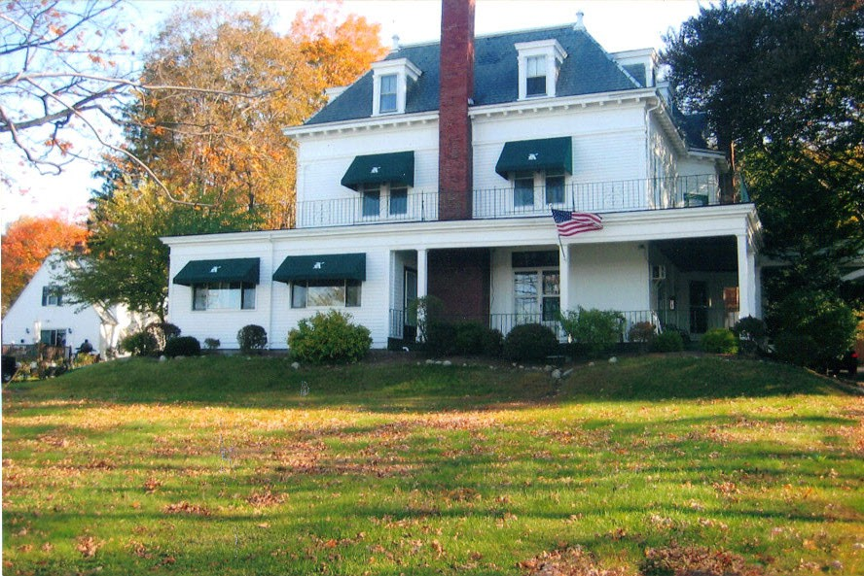
Shared housing
Individuals with substance use disorders
Abstinence-based
Peer recovery support
Operates as a family-like community
Notes:
Before we get into details, the definition of recovery housing – recovery residences – boils down to a few simple things.

Slide 14
Different property footprints:
Single-family detached dwellings, duplexes…
Apartment buildings or blocks of units
Converted from other types of housing
Special-purpose

Slide 15
Forming NARR
Early nudges
Coming together remotely
What do we all do?
What should a national organization do?
Atlanta, 2010: Should we do this? Can we do this?
Development year: creating the organization

Slide 16
Initial decisions
Support for the full spectrum of recovery residence models
support for multiple pathways, supportive of a wide variety of service models and recovery philosophies,
multidimensional definition of recovery, based on abstinence from alcohol and non-prescribed medications
commitment to the social model
Standards achievable by small, low-cost providers
Decentralization: based on state service organizations

Slide 17
Early milestones
SAMHSA/CSAT
NCAD Conference
Addiction Professional Magazine
Faces & Voices of Recovery
NASADAD
ONDCP
Recovery Residence Primer
William White
APA policy brief

Slide 18
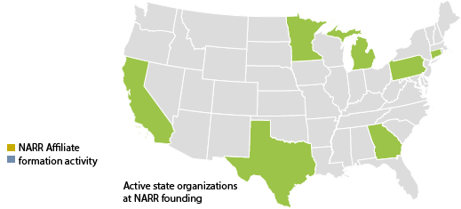
NARR in 2010

Slide 19
Present: Current system and programs

Slide 20
NARR services and programs
National best practice standards, code of ethics
Technical assistance to state, federal agencies
Formation, expansion of state standards/support organizations
Training
Leadership, organizational development
Residence operators
Residence staff
Certification staff
Training for trainers
Policy formation, development
Advocacy

Slide 21
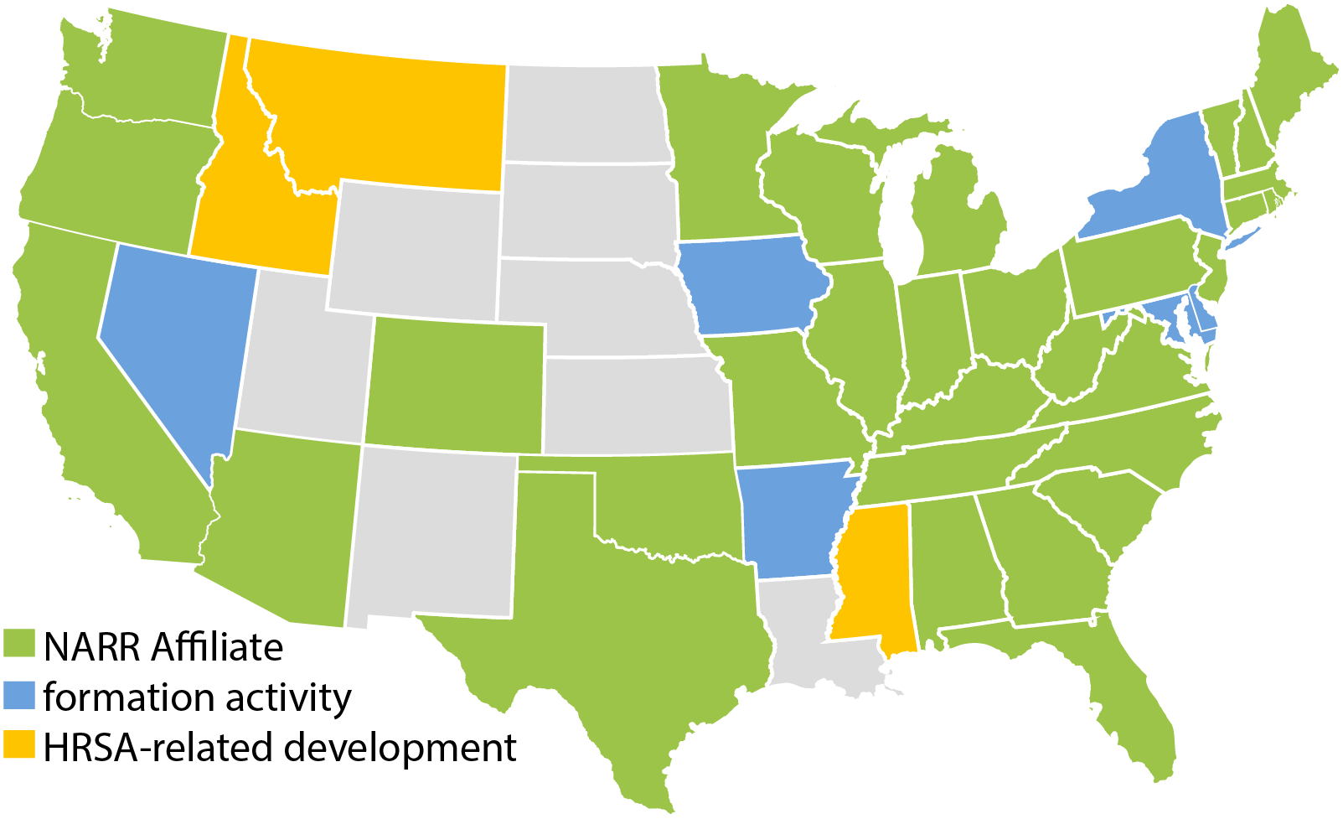
NARR network today
31 Affiliate organizations, nine being formed

Slide 22
State affiliate services and support
Certification of providers, residences according to NARR standards
Relationships with other stakeholder organizations, recovery community
Technical assistance to providers, new entrants
Resolution of complaints about certified residences
Provider learning community
Operator training (some affiliates)
Affiliate contact information through NARR, or at narronline.org

Slide 23
Residence certification
Annual process, NARR affiliate function
Formal application
Version 3 of national standard
Review of residence documents, policies & procedures
Structured interviews with operator, staff
Physical site assessment (health & safety, no overcrowding, property condition)
Technical assistance available to providers

Slide 24
Elements of a statewide recovery residence system
Standards, ethics based on national best practices
Provider accountability
Consumer information and protections
Provider support, continuing quality improvement
Training, workforce development
Integration into larger systems of care
Local expertise, policy resource

Slide 25
State system support elements
Recognition of standards, certification of residences
Incentives for becoming standards-compliant, submitting to oversight
Provisions addressing patient brokering, insurance fraud, misleading advertising
Address inadequacy of traditional medical/clinical licensure model
Funding for these elements:
Resident access, services
Capital costs, system expansion
System support

Slide 26
2018: Recovery housing policy guide
A joint effort between National Council and NARR with input from other stakeholders.
Provides state policymakers and advocates with strategies, tools, and policy language that support the infrastructure of recovery housing, quality operating standards, and protections for people in recovery.
Summary of existing state regulations
Highlights three main sections:
Protecting Recovery Housing
Supporting Recovery Housing in Practice
Sample Legislative Language

Slide 27
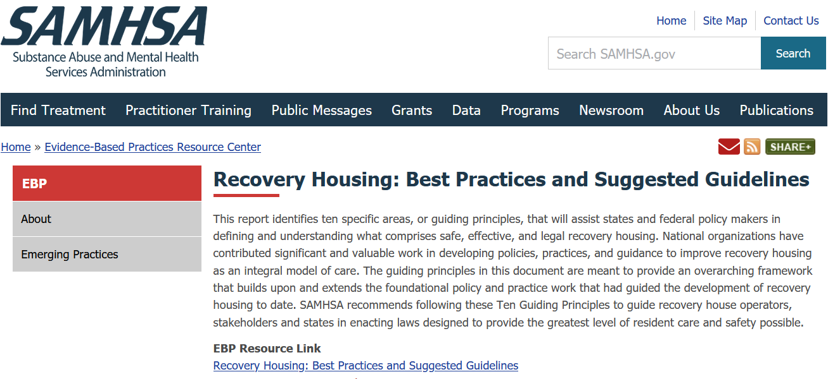
Recovery Housing is an Evidence-based Practice (SAMHSA)

Slide 28
State system adoption
Already adopted, working well
31 existing state organizations
10 in development
Legislative support: OH, FL, MA, IN, RI, MD, MO, WA, NH, ME, WV, VA
Legislation pending or to be introduced: TN, TX, OK, KY, others
Legislation to be introduced: Organizational development: DE, NY, IA, AR, MD, NV, MT, ID, MS, HI
Rural Center of Excellence target states: WV, KY, TN, OH, GA, OR, WA, ID, MT, MS

Slide 29
NARR Advocacy
Resident rights
Access to recovery housing and services
Civil rights, fair housing, discrimination
Abusive practices and exploitation
Resources to support recovery infrastructure
Policy development, federal and state

Slide 30
Policy work
Model state laws: recovery housing, abusive provider practices (ONDCP, SAMHSA, NAATP, NASADAD, NAADAC, other stakeholders)
Federal legislation: SUPPORT Act, Excellence in Recovery Housing Act, CARA 2.0, CARA 3.0, 2022 Congressional budget
State legislation, administrative rulemaking
Rural Center of Excellence in Recovery Housing (HRSA-funded project)
Partnering with other national organizations to improve our SUD systems, expand access to quality services

Slide 31
Future: Comprehensive system and support

Slide 32
Policy goals
Integrate recovery housing more completely into our solution to addiction
Fight stigma and discrimination:
Lack of parity with treatment of other diseases
Discriminatory federal, state, local government practices
Expand access to quality recovery housing
Expand, strengthen delivery, support systems
Expand capacity nationwide

Slide 33
Other
Credentials: operator, peer staff
Affiliate assessment process
Specialty practice credentials including COD, parent/child, MAR
National directory/locator
Training: delivery methods, languages, coverage
Fair housing

Slide 34
NARR Best Practices Summit
October 24 – 26, Richmond VA
Information and registration at narronline.org

