Slide 1
How to Use Outcomes Tool Data
Gretchen Clark Hammond, PhD, MSW, LSW, LCDCIII, TTS
Kathleen Gallant, BA

Slide 2
History of the Outcomes Tool
2014
Prior to 2014, there was no funding in the state budget for recovery housing. It was only through advocacy and data that this funding stream was created.
There was also no organization that had a sole focus on recovery housing. The establishment of ORH was essential to the growth of the field and essential to the needs of recovery housing providers to be heard.
Mar. 2016
Outcomes Tool Launches
ORH worked closely with the ORH Board, staff, operators, and the team at Mighty Crow to develop a web-based survey and data dashboard.
Between March 2016 and April 2022, over 11,500 surveys were submitted.
2021
After 5 years of use, an assessment of the Outcomes Tool was done
We looked at what data points were most useful, what additional data we wanted to be collecting, and what changes could be made to increase data clarity and accessibility for operators.
Technical upgrades were made to allow more users (such as county boards) access to the data.
May 2022
Outcomes Tool 2.0 Launches
The outcomes survey and data dashboard were re-launched. The user experience remained much the same, but now with higher quality data collection and display options.

Slide 3
Why did we opt for an online tool?
We wanted something that was ACCESSIBLE via desktop, laptop, or other mobile device.
We wanted something that did not require that software be installed on any one person’s machine.
We did not want to transfer paper all over the state (concerns about getting data, losing data, etc.).
We wanted something that would gather the data and do basic analysis in real-time.
We wanted something that would AUTOMATICALLY UPDATE questions if we made any changes.

Slide 4
Structure of the Outcomes Tool
Three time intervals for data collection: at move-in, six months into the stay, and at move-out.
Categories of questions include:
Demographics
Addiction history
Previous living situation and destination at move out
Economic and social circumstances (e.g., debts, documentation, parenting status)
Education and Employment
Experience with recovery and recovery supports
Recovery capital
Questions about their experience as a resident (upon move-out)

Slide 5
What does the data tell us?
Descriptive Research:
What do we know about residents who are moving into recovery housing?
What changes do they experience over time?
What do we know about residents who are moving out of recovery housing?
Qualitative Research:
What do residents want to tell us?

Slide 6
Outcomes Data: May – December 2022
283
Houses
4,130
Surveys
2,447
Move-in
433
Six months
1,250
Move-out
From the re-launch of the Outcomes Tool in May 2022 through December 31, 2022:

Slide 7
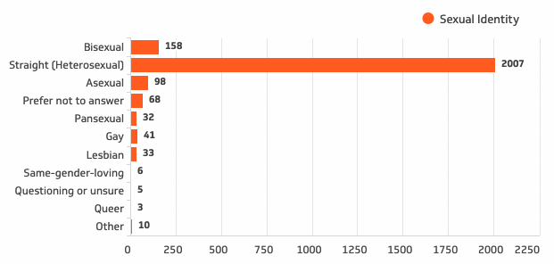
Demographics*
Gender
Sexual Identity
43% female
54%
male
Sexual Identity of Respondents at Move-In
*all demographic data measured at move-in unless otherwise noted

Slide 8
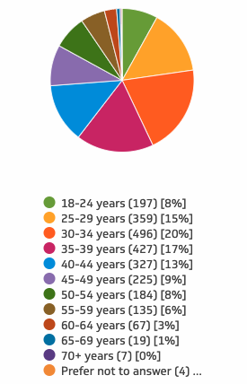
Demographics
Race and Ethnicity
Age
 | RH participants | Ohio census data*
White | 78% | 81%
Black | 16% | 13%
Non-Hispanic | 85% | 78%
*census.gov/quickfacts/OH

Slide 9
Demographics
Possession of Personal Documents
 | Drivers License | State ID | Social Security Card | Birth Certificate | At least one document
Move-In | 31.34% | 60.81% | 56.27% | 57.79% | 83.94%
Six Months | 48.27% | 72.52% | 76.44% | 81.06% | 97.00%
Move-Out | 35.68% | 60.56% | 65.28% | 64.08% | 82.08%

Slide 10
Demographics
Veteran Status: 3% had military service
Preferred Language: 99% English as a first language
Medicaid: 89% Enrolled in Ohio Medicaid

Slide 11
Mental and Physical Health
Number reporting mental health was “Good on most days” went from 47% at move-in to 60%+ at six months and move-out.
Number reporting physical health was “Good on most days” went from 56% at move-in to 66% at move-out.

Slide 12
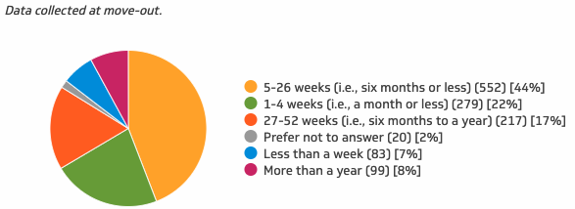
Length of Stay
29% stayed less than a month
44% stayed one to six months
25% stayed more than six months

Slide 13
Living Situation
32% came from out of county
21% homeless prior to move-in

Slide 14
Living Situation
Most likely to come from
Substance use treatment center
Residential project or halfway house
Incarceration
Most likely to move to
Staying with family
Staying with friend
Residence rented by them

Slide 15
Substance Use Disorder and Implications
Top 4 Substances of Abuse
Alcohol (52.0%)
Marijuana (47.4%)
Methamphetamines (44.0%)
Fentanyl (35.8%)
69% were clean for 30+
days at move-in
63% were in residential
treatment
13% were incarcerated
22% were not in treatment or
incarcerated
2% no response
80%+
reported
poly-substance use

Slide 16
Children and Parenting
71% have children under 18 years old.
Parents with children in custody of child welfare declined from 7.5% at move-in to 4.1% at move-out.
81.5% of parents reported improved relationships with their children at move-out.

Slide 17
Recovery Support Activities
 | Involved in 12-Step | Have a Sponsor | Any Recovery Activity
Move-In | 66.08% | 33.47% | 74.74%
Six Months | 94.23% | 71.59% | 96.30%
Move-Out | 85.20% | 52.08% | 88.48%
Most common recovery support activities were 12-step groups, sober support outings with friends in recovery, and activities sponsored by the recovery residence.

Slide 18
Peer Support

Slide 19
Income
Respondents with no income
57% at move-in
23% at
six months
Respondents with income over $25,000/year
5% at move-in
19% at move-out

Slide 20
Debt
Respondents Over
$5,000 in Debt*
Most Common Types of Debt
Court fees
Past due bills
Child support
Credit cards
50% at move-in
42% at move-out
*percentages taken from respondents who indicated having any debt, not total respondents.

Slide 21
Educational Status
Table 1. Current Educational Status Across Respondent Cohorts
 | General Ed/ GED | College | Vocational School | Skilled Training | Not Involved | Other
Move-In | 14.14% | 5.36% | 1.09% | 2.49% | 66.74% | 2.87%
Six Months | 8.89% | 7.11% | 4.00% | 11.11% | 60.44% | 2.67%
Move-Out | 9.48% | 5.04% | 1.93% | 3.56% | 49.19% | 2.37%

Slide 22
Educational Accomplishments
17.32% had achieved a high school diploma by six months.
14.80% had a achieved a high school diploma by move-out.
5.31% had achieved a technical/vocational certification by six months.
2.64% had achieved a technical/vocational certification by move-out.

Slide 23
Employment
Move-In
Six Months
Move-Out
23% unemployed and not looking for work.
7% working part-time.
10% working full-time.
6% unemployed and not looking for work.
23% working part-time.
38% working full-time.
15% unemployed and not looking for work.
13% working part-time.
29% working full-time.

Slide 24
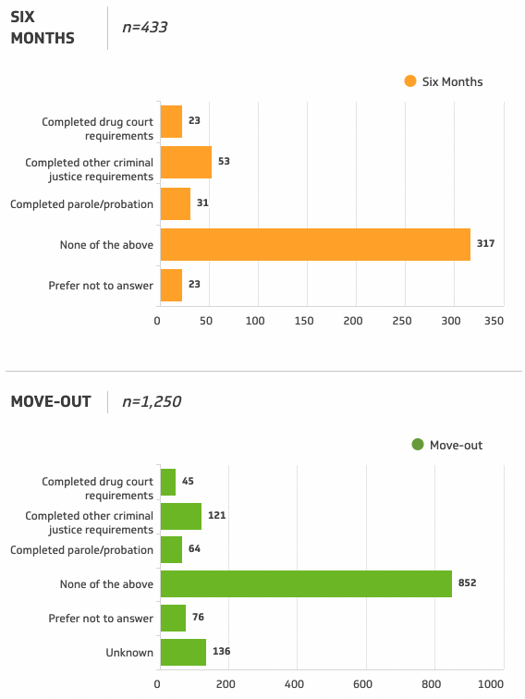
Criminal Justice
Accomplishments Since
Entering Recovery Housing
At any given time, slightly less than half of respondents were involved in the criminal justice system through parole/probation or drug court.
48% at move-in
45% at six months
44% at move-out

Slide 25
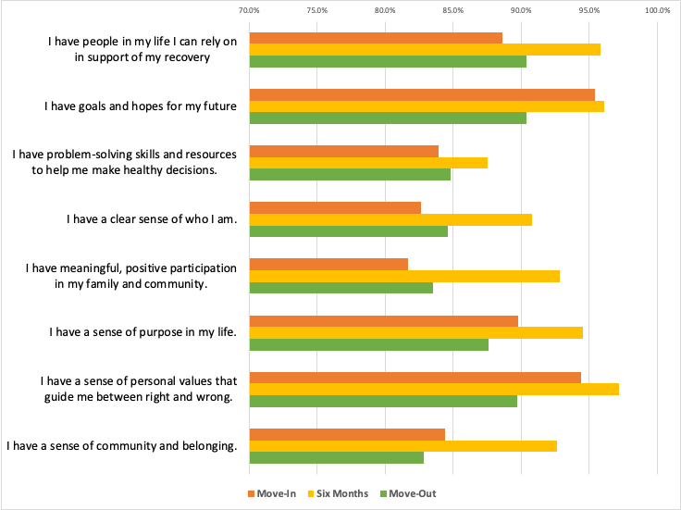
Recovery Capital

Slide 26
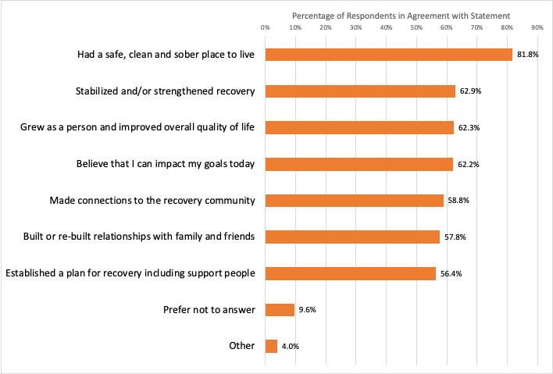
Four Dimensions of Recovery

Slide 27
Reason to Leave Recovery Housing

Slide 28
Open-Ended Questions
Why Should Someone Live in a Recovery Residence?
To move into a better place and find a focus on what really matters in life.
If one is willing it can help you build a foundation.
Helps reintroduce you to society
The impact of living in a community with like-minded people is what will save you.
It is a safe place for you to start the next part of your recovery.
How is Recovery Housing Different from Other Living Environments?
It is easier to focus on yourself.
Less triggers, safer, comfortable, not lonely.
Put me in place not to be judged.
Because there’s accountability and stability.
It gives you a chance to live on your own but still have some form of structure.
Why is Recovery Housing Needed?
It gives people a safe place to get their life together and to focus on their recovery.
So people can have a safe sober place to focus on learning to live sober.
I don’t know how to do it by myself.
Everybody needs a second chance.
Because it will help you apply everything you’ve learned to your everyday life.

