Slide 1
An ecological model of recovery capital and recovery capital measurement
Professor David Best
Leeds Trinity, Australian National University, Monash University, Recovery Outcomes Institute

Slide 2
What does a strengths-based process mean?
From expert-patient to partnership
From deficits to strengths
From clinic to community
From the individual to the social
From professional to peer-based
From replication to continuous innovation

Slide 3
John Kelly’s Model of the Burning House
Acute Treatment is putting out the fire
Recovery is about renovating the damaged building
This is a long-term process and it is not a straight or simple road
There is probably a 3-6 month of prolonged withdrawal that involves challenges around sleep, attention, general health, and cognitive function
William White has argued the key things at this time are around;
Diet
Exercise
Primary Health Care
Sleep Hygiene

Slide 4
So what is a recovery-oriented system of care?
White (2008): “the complete network of indigenous and professional services and relationships that can support the long-term recovery of individuals and families and the creation of values and policies in the larger cultural and policy environment that are supportive of these recovery processes” (page 28)

Slide 5
What enables recovery change?
Strength-based approaches
Leamy et al (2011), British Journal of Psychiatry
CHIME
Connectedness
Hope
Identity
Meaning
Empowerment

Slide 6
Our epidemic of loneliness and isolation: US Surgeon General’s Advisory on the Healing Effects of Social Connection and Community (2023)
“There is evidence of a dose-response relationship between social connection and health. This means that incremental increases in social connection correspond to decreases in risks to health, and conversely, decreases in social connection correspond to increases in risk”

Slide 7
Our epidemic of loneliness and isolation: US Surgeon General’s Advisory on the Healing Effects of Social Connection and Community (2023)
In 2016, only 16% of Americans reported that they felt very attached to their communities
There is a virtuous circle between social connection and volunteering or service

Slide 8
Our epidemic of loneliness and isolation: US Surgeon General’s Advisory on the Healing Effects of Social Connection and Community (2023)
From 148 studies, social connection increases the odds of survival by 50% - an effect stronger than changes in smoking, drinking and physical inactivity
Poor social connection is associated with a 29% increase in the risk of heart disease and a 32% increase in the risk of stroke
Chronic loneliness increases the risk of dementia by around 50% in older adults
A one standard deviation increase in social connection in community neighbourhoods is associated with a 21% reduction in murders and a 20% reduction in motor vehicle thefts

Slide 9
The Engine of Change
Measure
Plan
Empowerment
Engage
Hope
M⁴
Meaning, Mentor, Monitor, Measure
Connect
Identity

Slide 10
Recovery Capital: The concept of capital
“Social capital, human capital, recovery capital and restorative capital are unlike financial capital in that they are not depleted through use. When you spend your money from the bank, you deplete your capital. When you trust someone, you do not deplete trust: trust tends to be reciprocated and this engenders virtuous circles of trust-building. A politics of hope is likewise redemptive as we face adversity; it is infectious”
(Braithwaite, 2022, p. 363).

Slide 11
What is Recovery Capital?
Granfield and Cloud (2008) define recovery capital as
“The breadth and depth of internal and external resources that can be drawn upon to initiate and sustain recovery from AOD [alcohol and other drug] problems.”
White and Cloud (2008):
“Stable recovery best predicted on the basis of recovery assets not pathologies.”

Slide 12
Best and Laudet (2010)
Social Recovery Capital
Collective Recovery Capital
Personal Recovery Capital

Slide 13
The Logic of the Model
Recovery Group Participation Scale published in 2011
Assessment of Recovery Capital published in 2012
Too research focused, not enough clarity on how to use the answers
REC-CAP initial paper (Cano et al, 2017) created a model that combined assessment with care planning and the recovery evidence base
ARMS provided the platform that allowed this to be embedded in services and systems

Slide 14
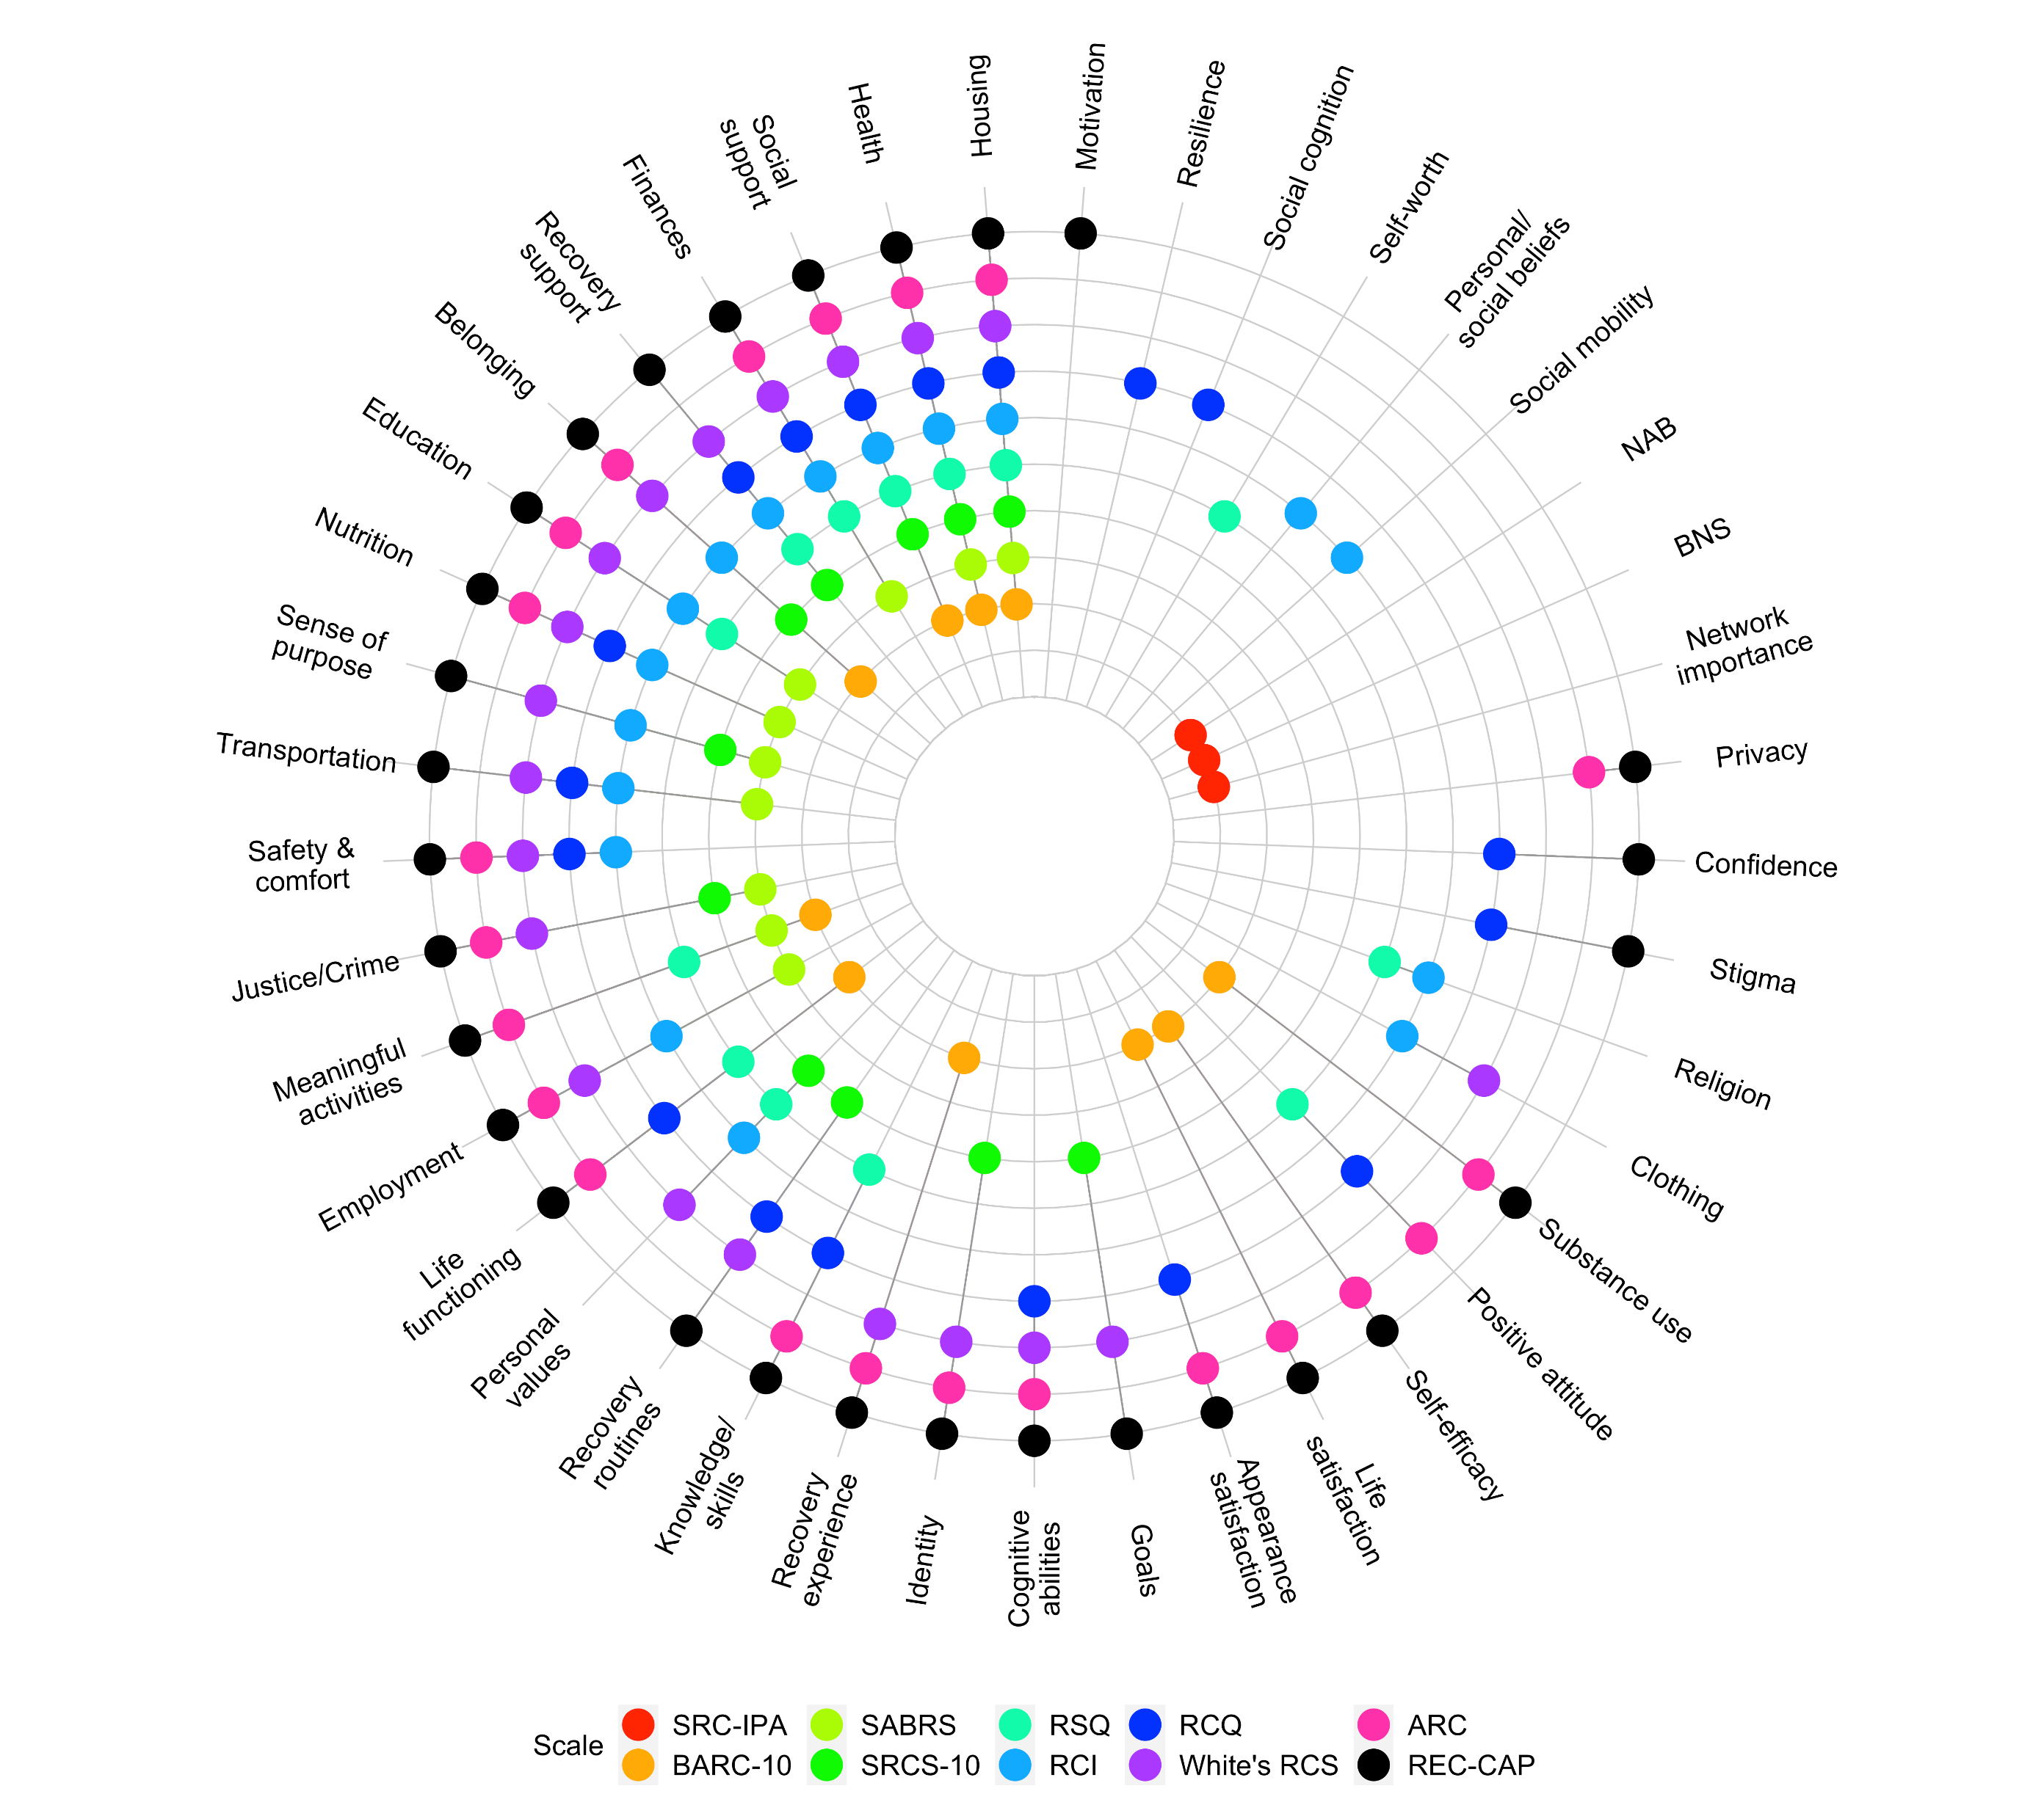

Slide 15
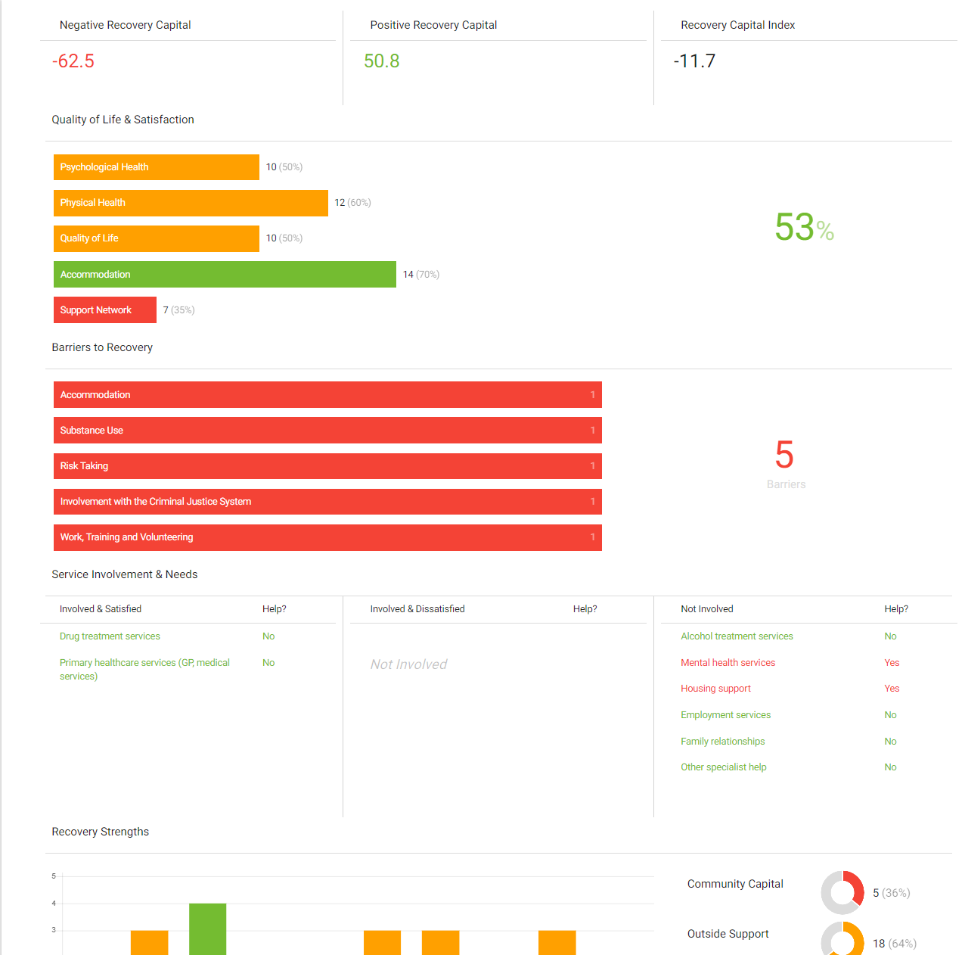
REC-CAP SCALES

Slide 16
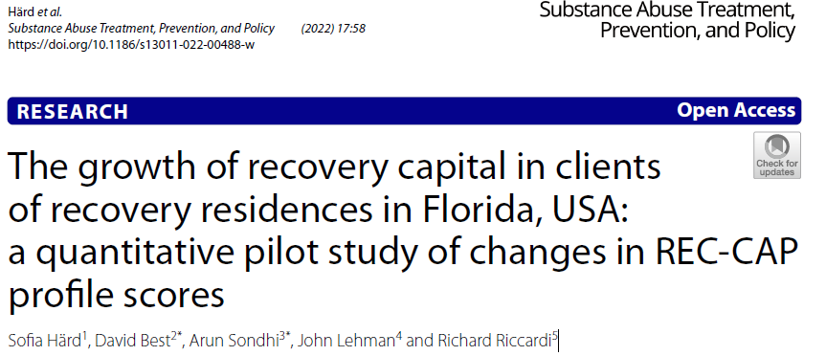
Mapping retention and changes in recovery capital

Slide 17
Fellowship Living – Changes in recovery capital (Hard et al, 2022)
Poorer retention was associated with being:
Younger
Female
Lower involvement in recovery groups
Those with greater needs around housing

Slide 18
Virginia Association of Recovery Residences (Best et al, 2023)
Key political implications around younger, non-white clients and women less likely to be retained
For those retained, positive change associated with:
Employment
Greater recovery community involvement
Less housing instability
Better social support

Slide 19
Chesterfield HARP Changes in REC-CAP Metrics (Best et al, in press)
Metric | At Baseline | At Last Episode
PRC
Chesterfield HARP | 18.5 | 21.3
Other Clients | 18.7 | 21.0
SRC
Chesterfield HARP | 19.7 | 22.1
Other Clients | 18.9 | 21.5
RGPS*
Chesterfield HARP | 9.6 | 11.6
Other Clients | 7.5 | 10.8
REC-CAP Index
Chesterfield HARP | 28.1 | 48.1
Other Clients | 20.4 | 45.2
Chesterfield HARP clients improve at the same rate as all other clients, but they have higher baseline RCI scores
Chesterfield HARP clients scores for RGPS do not increase at the same rate as other clients suggesting a possible area for development

Slide 20
Best et al (in press) – “Bridging the gap: Building and sustaining recovery capital in the transition from prison to recovery residences
Based on the HARP Therapeutic Community Model at Chesterfield County Jail
Clear evidence of recovery capital building in jail
But this continued to recovery residences and clear evidence of continuing and linear evidence of growth
Journal of Offender Rehabilitation

Slide 21
So where are we up to now
Approximately 12 000 single REC-CAP completions for approximately 4300 individuals across multiple assessment times.
Recovery residences across the US, including Michigan, Maine, Virginia, West Virginia, Florida, and Washington.
Individuals aged from 18 to 77 years (mean age 39 years).
Approximately two-thirds are males and one-third females. Approximately one percent reported other gender than male or female.

Slide 22
Overall Recovery Capital Score (ORCS)
The ORCS = recovery strengths minus recovery barriers.
The ORCS increased over time.
Males tend to report higher mean ORCS over time, compared to females.

Slide 23
Recovery barriers and unmet needs
The mean number of barriers decreased over time.
Women continuously reported more barriers compared to males.
At baseline, most unmet needs were around primary healthcare services, mental health services, and employment services.
Unmet needs decreased over time across all types of service needs, however, most unmet needs remained around housing support services.

Slide 24
Pilot vulnerability score
A pilot vulnerability score was created based on Cloud & Granfield’s (2008) conceptualisation of four factors that may impose challenges to recovery:
- Having mental health difficulties
- Experience of incarceration
- Female gender
- Being older
The pilot score could range from 0 to 4 vulnerabilities.
Individuals with more vulnerabilities reported less recovery capital.

Slide 25
Future research around goals and discharge reasons
Over 98450 unique goals across 1584 individuals.
Most goals were around barriers (44%), followed by personal capital (21%), community capital (16%), and service needs (13%).
5504 unique discharge reasons for 3499 individuals.
Three most common discharge reasons were other voluntary discharge (19%), program abandonment (17%), and recurrence of use (15%),

Slide 26
Measure, Plan, & Engage (MPE)
REC-CAP
EVALUATION
Recovery
Planning
Navigational
Support
Measures seven (7) domains of Recovery Capital at 90-day intervals, reporting longitudinal growth over time
Utilizes REC-CAP Results to suggest a Recovery Plan focused on resolving Barriers & Unmet Service Needs and building Recovery Strengths
Delivers a structured RSS where-in a Navigator mentors, monitors & measures Client’s engagement in their Recovery Plan

Slide 27
What is the point of the Engagement component?
Connection to Community Resources
Identify and engage community assets
Create pathways to prosocial groups
Meet individual life needs and aspirations
Build hope and strengths
Personalised interests and activities compatible with skills and needs

Slide 28
Connectors Results and Implications
21 connectors in approximately three months
134 community assets were identified
This was used to link people new to recovery into meaningful assets
To build personal capital, social and community capital, act as the scaffolding
This involves effective linkage to community groups
Using community connectors + Assertive Linkage + Ongoing Support

Slide 29
Manning et al (2012)
Problem
Trial Conditions
Outcomes
Acute Assessment Unit at Maudsley Hospital:
Low client meeting attendance rates while on ward
RCT with three conditions:
Information only
Doctor referral
Peer support
Those in the assertive linkage condition:
More meeting attendance on ward (AA, NA, CA)
Reduced substance use in the three months after departure

Slide 30
Who needs community engagement?
Community Connectors
What steps are necessary?
Asset Based Community Mapping
Training and developing community connectors
Preparing clients to engage with groups
(and assessing their readiness)
Feedback loops and mutual benefit
Creating in-reach and out-reach models
1
Those who are socially isolated and excluded
Those whose networks are harmful to their recovery
2
3
4
5

Slide 31
The origins of the model: Recovery Oriented Systems of Care
White, W. (2008) Recovery Management and Recovery-Oriented Systems of Care: Scientific Rationale and Promising Practices. North-East and Great Lakes ATTC
Sheedy and Whitter (2009) Guiding Principles and Elements of Recovery Oriented Systems of Care (SAMHSA)
Kelly, J. and White, W. (2011)(eds) Addiction Recovery Management. Humana

Slide 32
So what is a recovery-oriented system of care?
White (2008): “the complete network of indigenous and professional services and relationships that can support the long-term recovery of individuals and families and the creation of values and policies in the larger cultural and policy environment that are supportive of these recovery processes” (page 28)

Slide 33
What are the elements of an ROSC
Person-centred; Inclusive of family and other ally involvement; Individualized and comprehensive services across the lifespan; Systems anchored in the community;
Continuity of care; Partnership-consultant relationships; Strength-based; Culturally responsive;
Responsiveness to personal belief systems; Commitment to peer recovery support services; Inclusion of the voices and experiences of recovering individuals and their families;
Integrated services; System-wide education and training; Ongoing monitoring and outreach; Outcomes driven; Research based; and Adequately and flexibly financed.
SAMHSA, 2009

Slide 34
So what is different about Inclusive Recovery Cities?
They are ROSCs ++
The key additional elements are about:
Coordination and integration
Innovation
Social enterprise
Giving back
An Inclusive Recovery City is a city where the implementation of recovery models and principles makes the city a better place to live for everyone, and which implements an ROSC at a city level

Slide 36
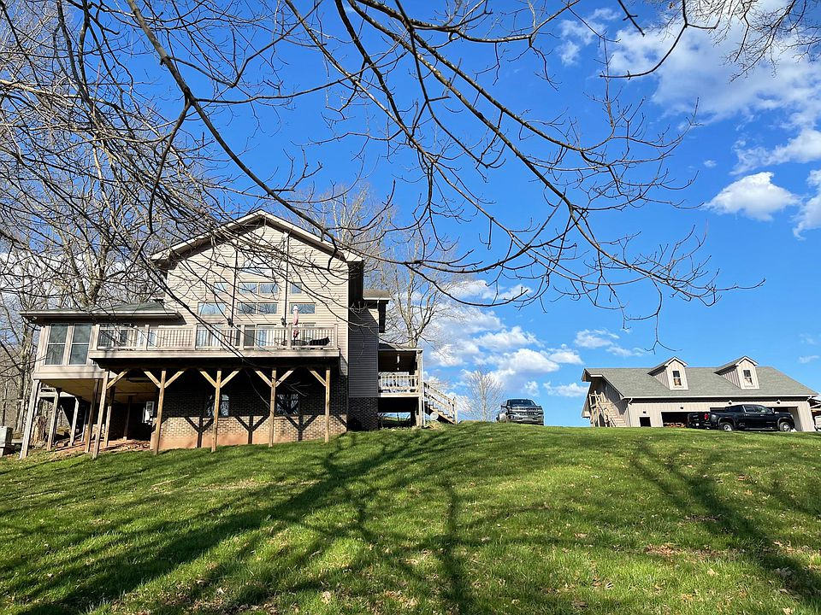
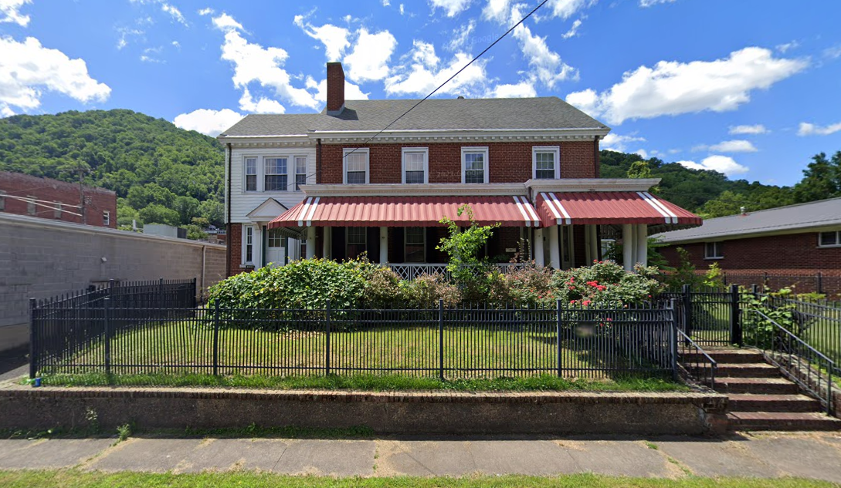
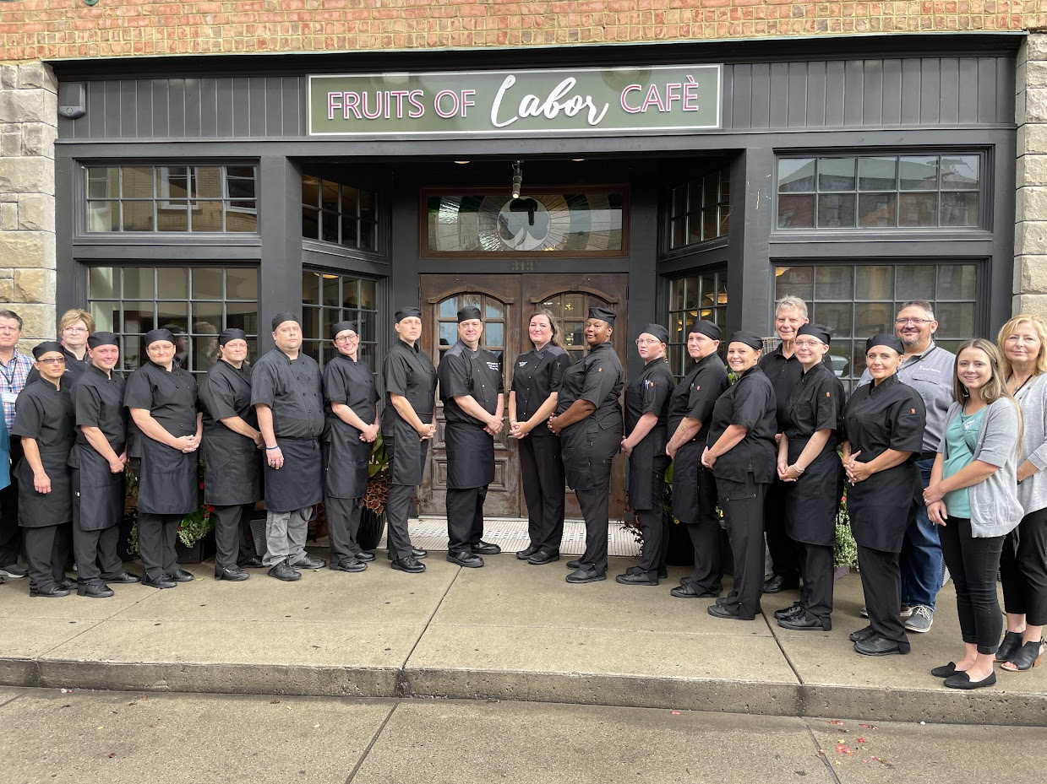
The Ecosystem
Seed Sower
NARR Level III Housing
Transportation
REC CAP
Recovery Support Services
Group meetings
Peer-Led Social Model
24/7 onsite Peer Recovery Support
Pro-social networking
Community engagement and service
Fruits of Labor
American Culinary Federation certified Quality Program
Training from 12 weeks up to Chef
Culinary certifications
Recovery-friendly workplace
On-site peer recovery support
85% program completion rate over 10 years
Additional support:
Workforce development agency (WorkForce WV)
Rural recovery support and assistance (The Fletcher Group)
Federal Agencies (Appalachian Regional Commission)
Behavioral health care providers
State Bureau for Behavioral Health
Housing assistance organizations
Education (WV Adult Ed)

Slide 37
The politics of recovery
“As we have demonstrated throughout this book, a person’s structural relations in society and the relationships, networks and other assets that adhere to one’s social position greatly affect one’s chances for recovery …… ” Granfield and Cloud, 1999, p.178
“Much of the impetus and motivation to change was associated with conditioning factors in their social environments that supported their desired change. The process of change, as demonstrated by our respondents, rarely occurs in isolation. Instead personal transformation is a social product that is greatly influenced by the situational social contexts in which an individual is located” Granfield and Cloud, 1999, p.194

Slide 38
Key concepts and conclusions
CHIME
Recovery Capital
Contagion and community
Cascades for professionals to mirror contagion for individuals
ROSC and Inclusive Recovery Cities
From the social to the ecological

Slide 39
THANK YOU!
D.Best@leedstrinity.ac.uk www.cultivatingrecoverycapital.com

